Slide 1

Planning Recommendation system
Sit Dolor Amet

Slide 2
Problem Statement
Our world is grappling with unprecedented situation, due to Covid-19 Pandemic. There is waves after waves of infection and no one is sure for how long these situation is going to continue
World over the Planning departments of governments are struggling to find the correct balance on when to hit the Pause button and when to restart, the economic activity .
Mostly the actions by planning departments across the world are reactive in nature and that results into losses towards lives and livelihood. Therefore Road to recovery is often patchy and full of potholes.
How can we change this narrative and help Planning departments to predict and plan the Road to Recovery better.

Slide 3
Solution Approach
We intent to assist the planning department by deploying intelligent technology solution , which not only predicts the trend of the Covid , but also recommends when to Lockdown and when to unlock.
It can also be configured to provide a phased manner lockdown and unlock approach based on Real time data input.
These recommendation are based on deploying artificial intelligence to forecast Typical Covid wave patterns and then applying a logic to provide recommendation to City wide planning department on a predefined department policy.

Slide 4
Components
Screen Flow
Prediction Engine
Recommendation Engine
Our solution has 3 basic part
Screen Flow, which guides the user towards Prediction and recommendation process flow.
Prediction Engine, is the Artificial intelligence driven system, which predicts the Covid wave patterns and Vaccination coverage forecast, based on the historical data and real time data stream
Recommendation Engine, This takes into account inputs from Prediction Engine forecast and Policy guidelines from Department to suggest the next best action for the department

Slide 5
Functional Architecture
Capture
Select Region
Provide Date Range
Submit
Predict
Show Prediction chart
Day wise view
Recommend
Phased Lockdown
Phased Unlock
Data collation
Past Data
Real time data stream
Regional Data
Trained Artificial Intelligent Model

Slide 6
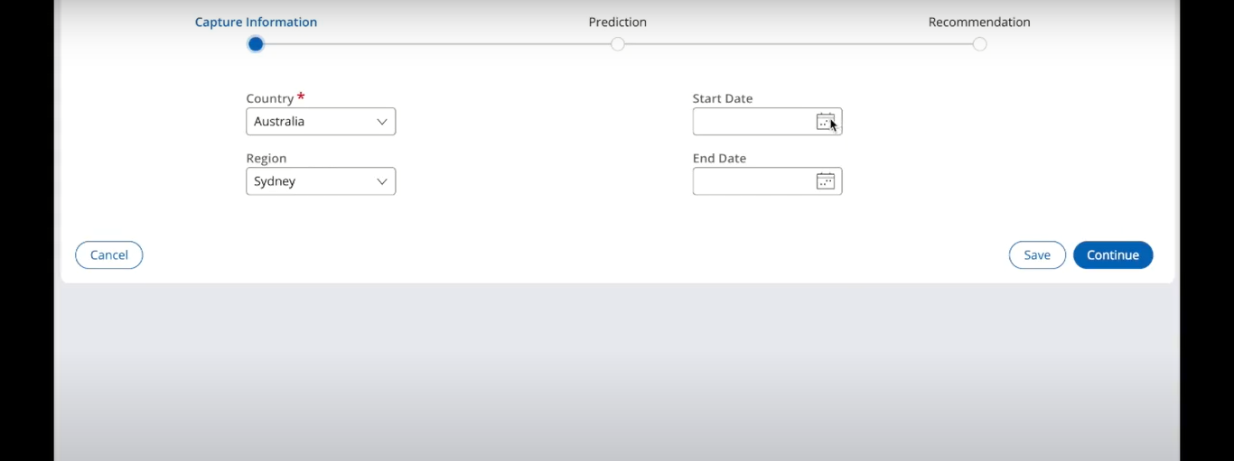
Screen Flow – Capture

Slide 7
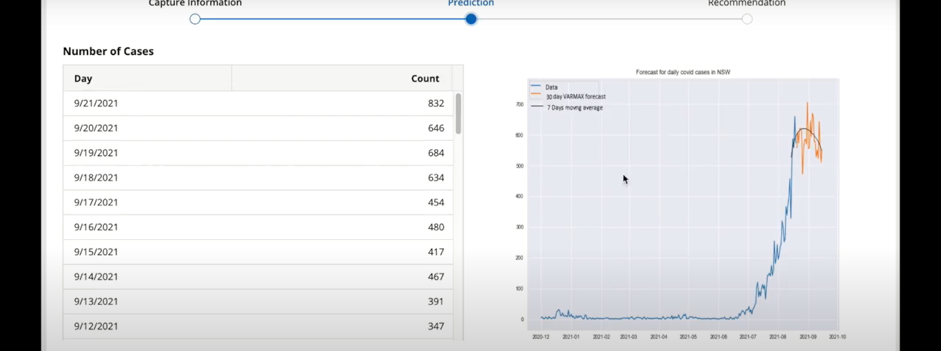
Screen Flow - Predict

Slide 8
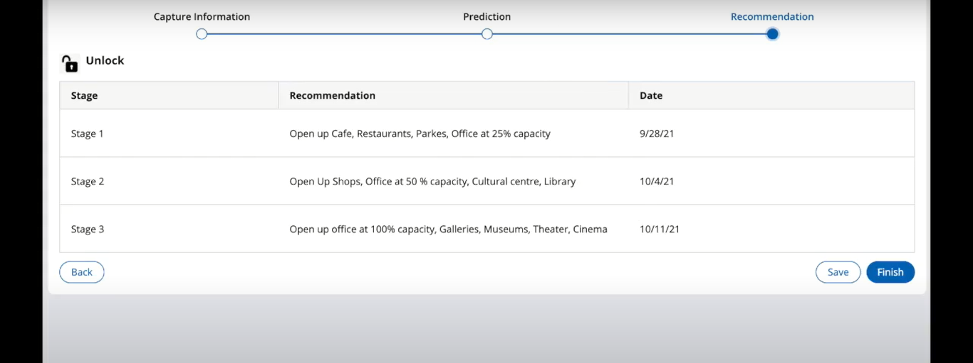
Screen Flow - Recommend

Slide 9
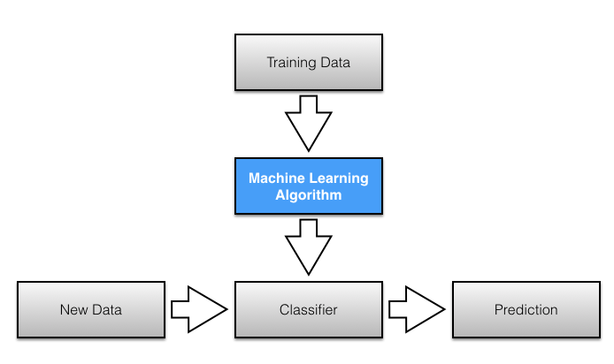
Model Training and Development
Include Comments against each boxes

Slide 10
Conceptual Architecture
User Interface
BPM Engine
Rule Engine
Predictive Analytics
Knowledge Hub
Engine 1
R2R Prediction Engine
Engine 2
Data Hub
Historical Data
Real Time Data

Slide 11
Benefits and other application
This system is built primarily to assist Planning department to plan and predict better.
It also enables a more coordinated and proactive action for the department ,coming out of a crisis such as Covid.
This platform currently uses very limited set of data to build its prediction but the horizon can be expanded to include more data variables to forecast better .
Similarly on the other end the application of such a tool is manifold and is applicable to town planning, by tracking the people behaviors post pandemic.(such as people moving to suburbs from city centers)
Or Predicting the traffic load on the Public transport system , when the crisis subsides.

Slide 12
Your best quote that reflects your approach… “It’s one small step for man, one giant leap for mankind.”
- Neil Armstrong

